Slide 1
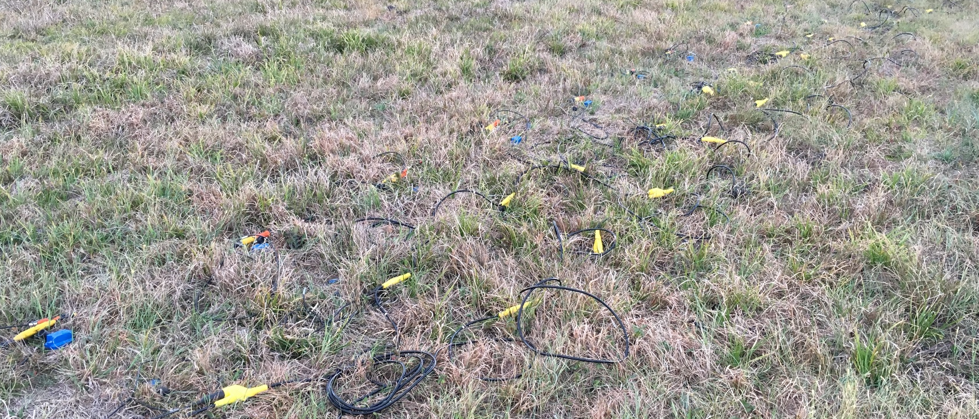
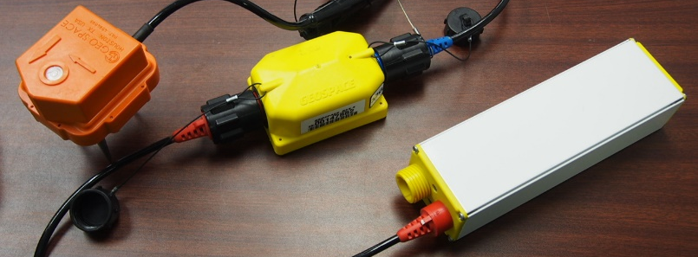
a.
1m
1m
1m
Traditional Cabled Geophones
Connectors
Trunk Cables
b.
Battery
Seismic Recorder Unit
Geophone

